Slide 1


Slide 2
Natural Language Processing
Vince Casbarro

Slide 3
objectives
Define NLP
Determine purpose of NLP
Intro to low-level NLP tasks
Dive into a fewhigh-level NLP tasks

Slide 4
What is it?
NATURAL: human based, human created
LANGUAGE: grammar and lexicon (some rules and some words)
PROCESSING : easy for humans, hard for computers
Notes:
Natural: can be inforal or formal, multilingual, written/spoken
Language: grammar, lexicon, but also morphology, phonetics, semantics, pragmatics
Processing: transcription, sentiment, meaning, similarity, negation, intent
Bag of words (disregard order and syntax, keep word count) see example in atom
Bag of concepts (a little better than BOW, groups concepts together)
Bag of narratives (the future!)

Slide 5
What’s the goal?
Get a machine to understand human language (Add structure to a highly unstructured data source)
Do stuff with that ability!
Notes:
Structuring a highly unstructured data source
Human language is astoundingly complex and diverse. We express ourselves in infinite ways, both verbally and in writing. Not only are there hundreds of languages and dialects, but within each language is a unique set of grammar and syntax rules, terms and slang. When we write, we often misspell or abbreviate words, or omit punctuation. When we speak, we have regional accents, and we mumble, stutter and borrow terms from other languages.
While supervised and unsupervised learning, and specifically deep learning, are now widely used for modeling human language, there’s also a need for syntactic and semantic understanding and domain expertise that are not necessarily present in these machine learning approaches. NLP is important because it helps resolve ambiguity in language and adds useful numeric structure to the data for many downstream applications, such as speech recognition or text analytics.

Slide 6
“Environmental regulators grill business owner over illegal coal fires.”
“Do you think it’s cold in here?”
“What did you do this weekend?”
Notes:
Do you take things literally or not?
What’s the intention? Asking a person’s opinion, or asking for reciprocation? Making a request?

Slide 7
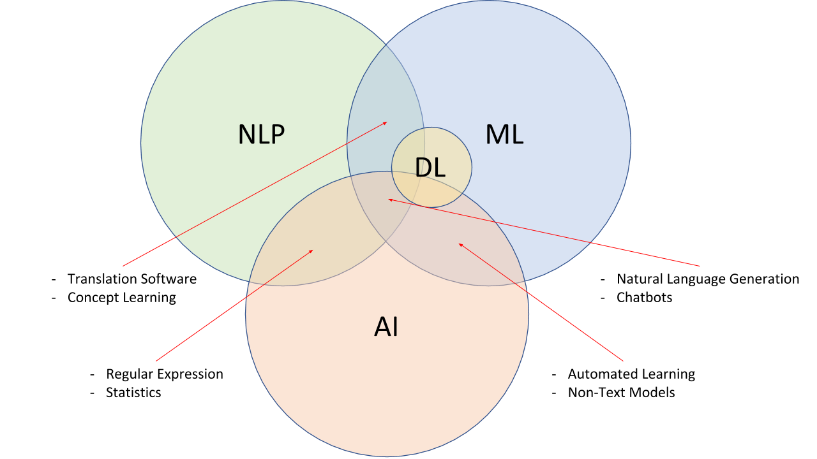

Slide 8
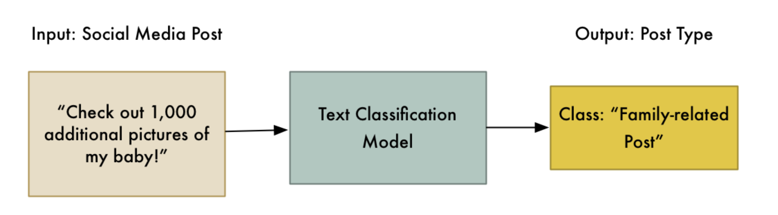
Examples!
Bayesian spam filtering
Voicemail transcript
Woebot
Sepsis early intervention
Notes:
Show woebot, gmail auto-complete

Slide 9
Low Level NLP Tasks
Tokenizing
Parsing
Lemmatization & Stemming
Part-of-Speech Tagging
Language Detection
Notes:
Tokenizing: breaking up a string into tokens (which can be any typical grouping for further analysis) – more difficult than meets the eye: aren’t, M*A*S*H, etc.
Parsing: syntactic analysis (parsing tree)
Sometimes called the “NLP Pipeline”
Parsing: encompasses IDing the semantic relationship: dependency parsing

Slide 10
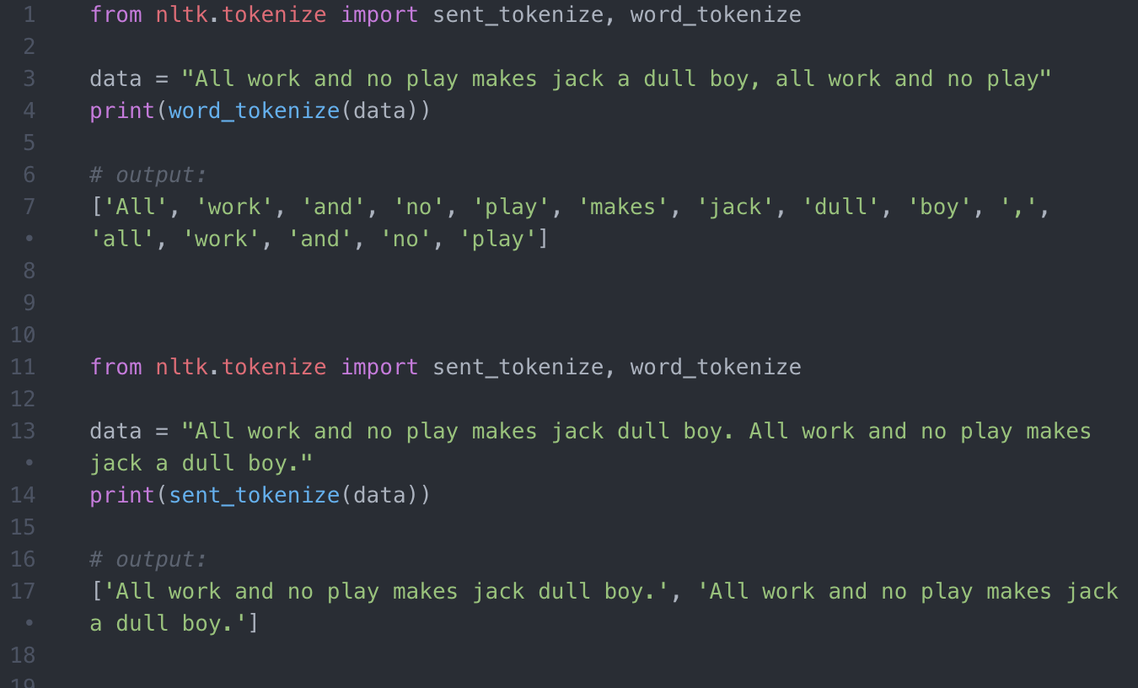
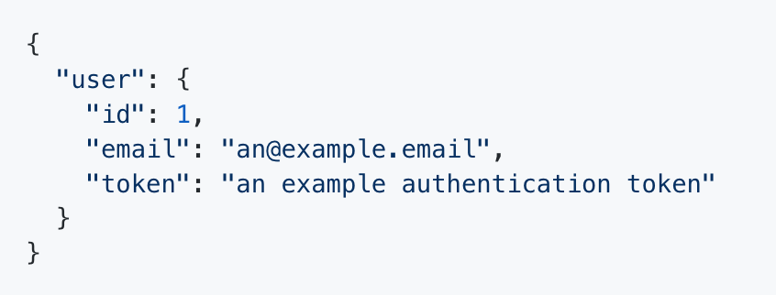
Tokenizing

Slide 11
Parsing

Slide 12
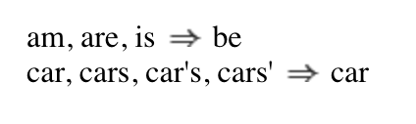
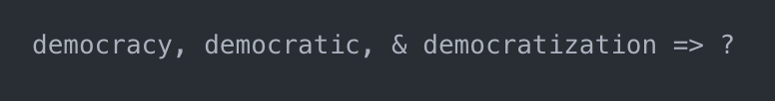
Stemming/Lemmatization
Notes:
Stemming: chopping off part of the word to get the root (or stem)
Lemmatization: getting the base form(democracy, democratic, and democratization)

Slide 13
High Level NLP Tasks
Sentiment Analysis
Context Extraction
Summarization
Content Categorization
Topic Modeling
Speech to Text, Text to Speech
Machine Translation and Interpretation
Notes:
Only going to focus on the first 3 (which I think are the coolest)

Slide 14
follow me

Slide 15
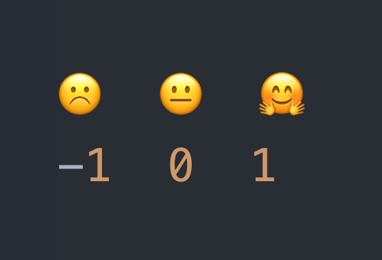
Sentiment Analysis
Notes:
Supervised machine learning or deep learning approaches (train on a large dataset)
- Training set might be composed of reviews && the known sentiment (or in this case, maybe 0-5 star ratings)
Unsupervised lexicon-based approaches (give the computer some rules instead of a dataset)
Scores area assigned based on content metadata
Positive and negative values (can be a range) can be assigned to polarizing words
Bag of words
What about negation?
Usually done on the sentence/paragraph level, and then aggregated if getting the whole document.
Pseudocode some examples

Slide 16
Content Extraction & Summarization
Notes:
Semi-structured Statement Extraction

Slide 17
bibliography
https://www.sas.com/en_us/insights/analytics/what-is-natural-language-processing-nlp.html
https://towardsdatascience.com/an-easy-introduction-to-natural-language-processing-b1e2801291c1
https://www.altoros.com/blog/natural-language-processing-saves-businesses-millions-of-dollars/
https://www.slideshare.net/secret/nOMzKg6innooJG
https://nlp.stanford.edu/IR-book/html/htmledition/tokenization-1.html
https://nlp.stanford.edu/IR-book/html/htmledition/stemming-and-lemmatization-1.html
https://medium.com/@ageitgey/text-classification-is-your-new-secret-weapon-7ca4fad15788
https://www.sas.com/en_us/insights/articles/analytics/using-analytics-to-prevent-sepsis.html#/
https://blog.algorithmia.com/introduction-natural-language-processing-nlp/
https://blog.algorithmia.com/create-your-own-machine-learning-powered-rss/
https://blog.bitsrc.io/11-javascript-machine-learning-libraries-to-use-in-your-app-c49772cca46c
https://www.kdnuggets.com/2018/08/emotion-sentiment-analysis-practitioners-guide-nlp-5.html

